Slide 1
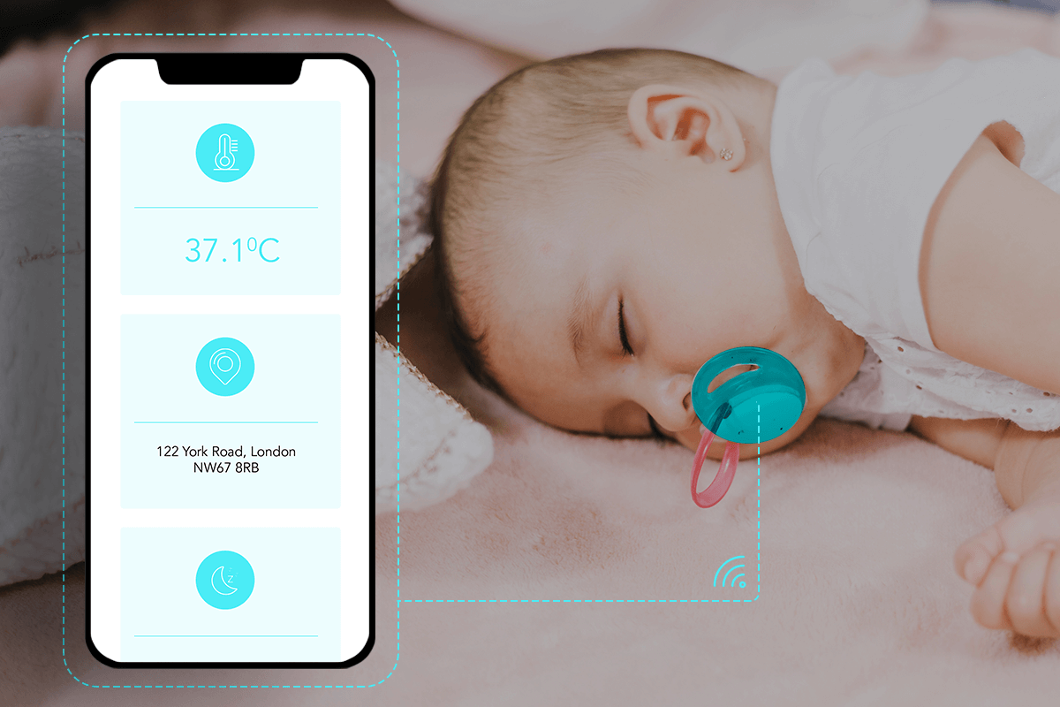
Empowering Parenthood: Introducing a Smart IoT Protection System for Baby's Room
A Safer Haven for Your Little Ones…
Peleg Segal & Michal Elbaz
14.3.2024

Slide 2

Key Features
Peace of Mind Monitoring:
Instantly track and receive alerts on room conditions for a safer sleeping environment.
Smart Security Features:
Enhanced protection with sensors detecting hazards and unauthorized access.
Optimized Health and Comfort:
Automated adjustments for ideal conditions, promoting better sleep and overall well-being.

Slide 3
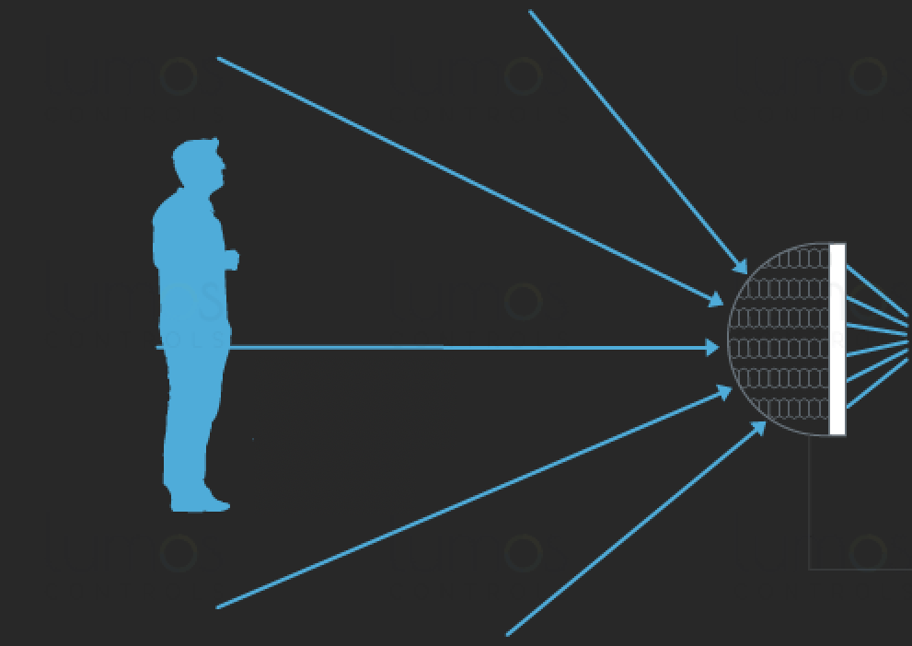
Main Components
PIR Sensor HC-SR501 (motion)
Humidity and Temperature Sensor DHT11
ESP32
MQTT
AWS
Ghidra

Slide 4

Room Conditions
Our system ensures real-time monitoring of temperature and humidity, prominently displaying the data for quick assessment.
In cases of excessively high or low temperature or humidity levels, the system triggers a red or orange LED indicator, providing a visual alert for immediate attention.
With an easy-to-read display and color-coded LED notifications, caregivers can swiftly respond to unfavorable environmental conditions in the baby room, enhancing safety and comfort.

Slide 5
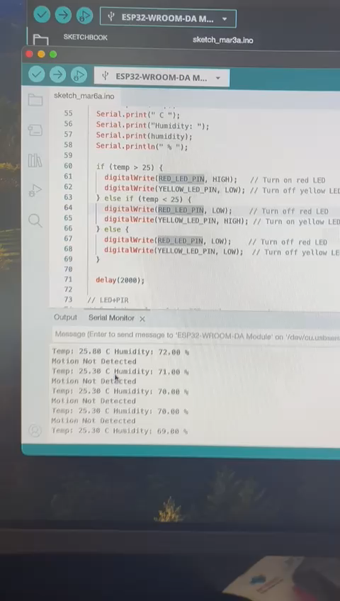

Slide 6

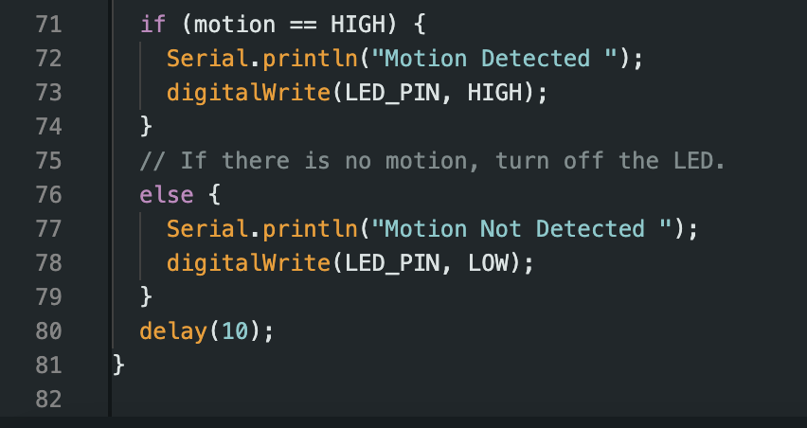
Safe Nest
An integrated Motion Sensor acts as a vigilant guardian, instantly activating a red LED alert upon detecting unexpected movement within the baby room.
When the Motion Sensor surpasses the predefined threshold, the system responds with a visible warning, allowing caregivers to promptly address any potential disturbances or unauthorized entries.
Enhancing security, the IoT system's Motion Sensor ensures a proactive approach by illuminating the red LED, providing an immediate visual cue to monitor and safeguard the baby room against unforeseen events.

Slide 7
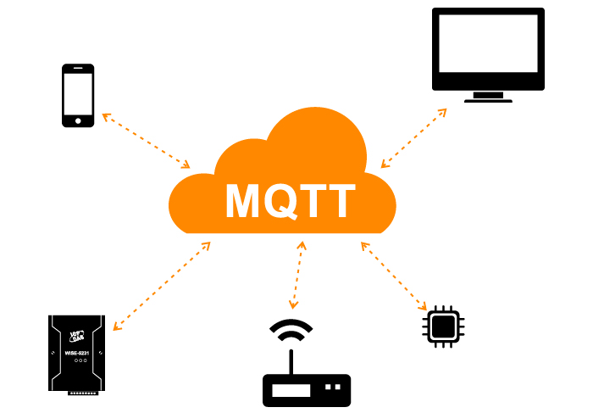
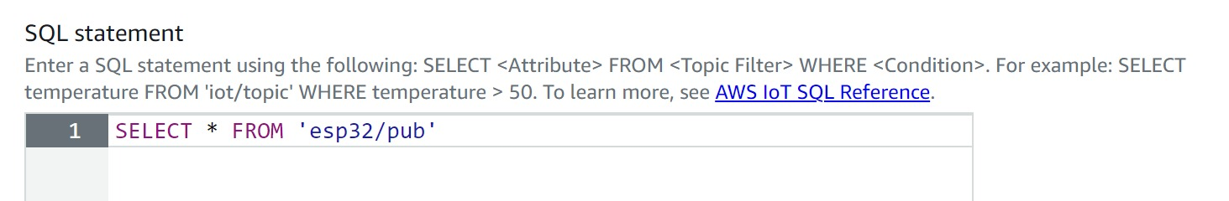
MQTT (Message Queuing Telemetry Transport)
A lightweight and efficient messaging protocol designed for communication in low-bandwidth, high-latency, or unreliable networks.
In your system, the ESP32 utilizes the MQTT protocol (through MQTT brokers) to establish a reliable and streamlined communication channel with the AWS cloud.

Slide 8

Secure Sync Baby
Effortless Connectivity:
Seamlessly linked to your home Wi-Fi, the IoT system employs MQTT to establish a secure and efficient connection with AWS, facilitating real-time data transfer between the baby room and the cloud.
Real-Time Data Exchange:
Through MQTT, the system ensures constant, bidirectional data flow, allowing for instantaneous updates on temperature, humidity, and motion events between the baby room and AWS servers.
Robust Cloud Integration:
Leveraging AWS, the system not only ensures data security but also enables smooth data synchronization, providing caregivers with instant access to vital information and historical trends for comprehensive baby room management.

Slide 9
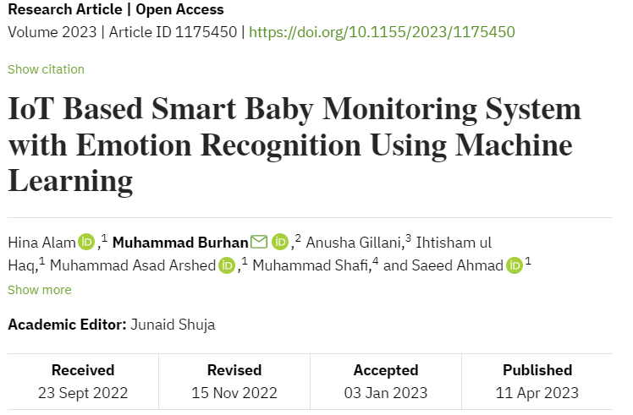
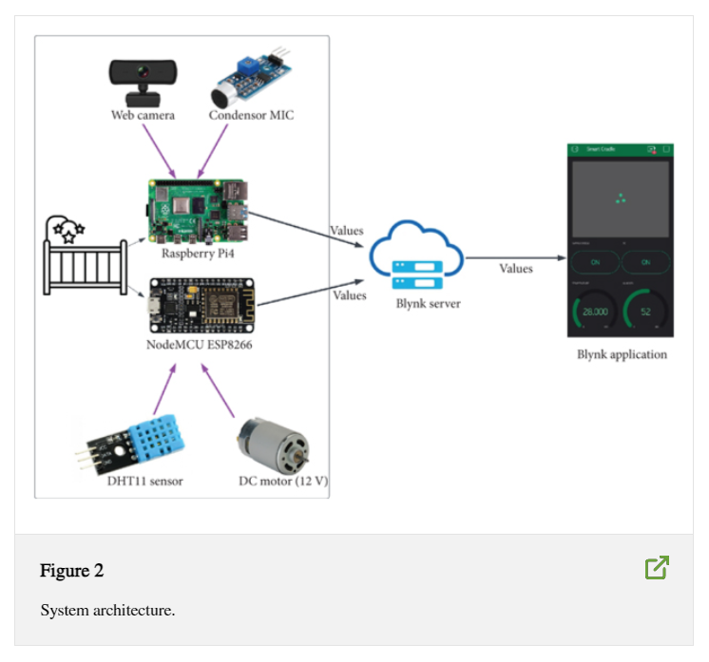
Related Article

Slide 10
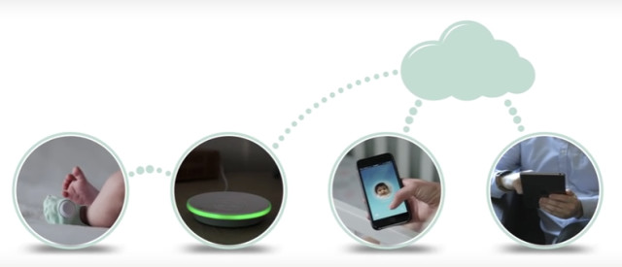
Main Idea
Core:
The ESP32 functions as the core platform of our system, acquiring data from sensors through a secure WiFi network. Subsequently, it transmits this gathered data to the next processing station for additional analysis and actions.
A robust connection to a secured WiFi network, ensuring data integrity and safeguarding against unauthorized access. This secure connection is pivotal for reliable communication, enhancing the overall resilience of the system.
Utilizing the MQTT protocol, our system facilitates seamless communication between the ESP32 and AWS, ensuring efficient and secure data transfer. This integration with AWS empowers cloud-based storage processing and accessibility for caregivers.

Slide 11
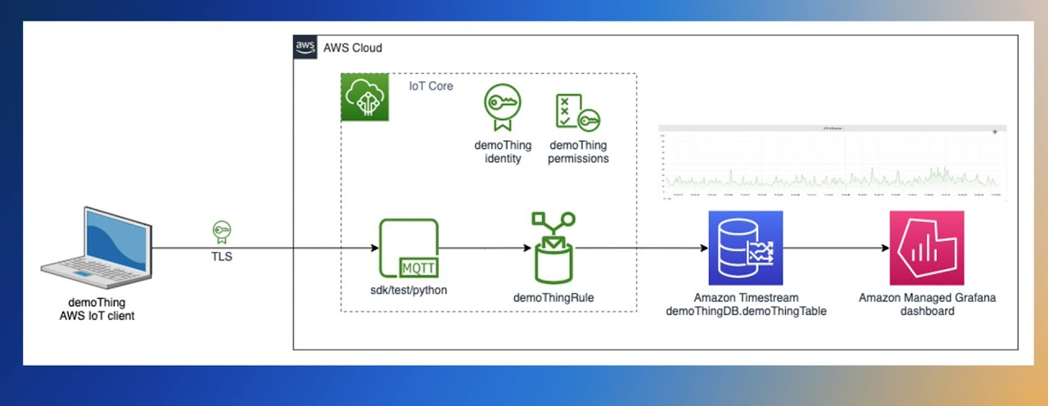
AWS Platforms
IoT Core
TimeStream
Grafana

Slide 12
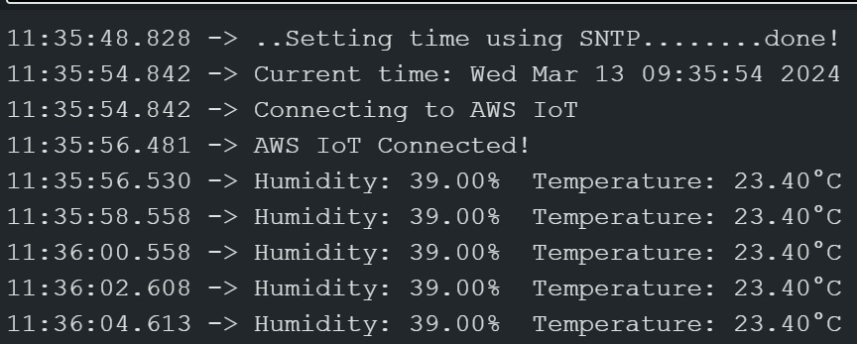
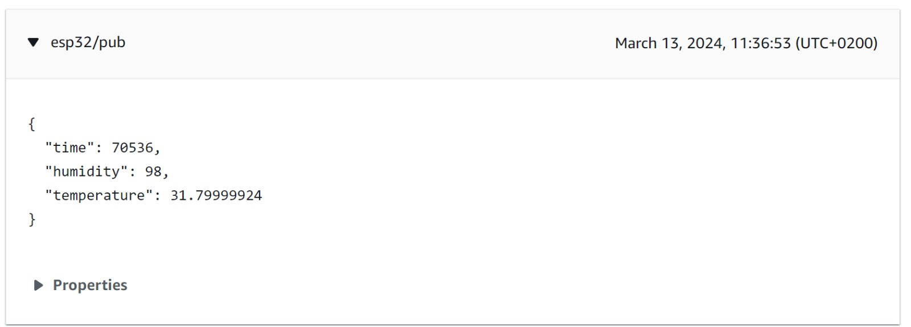
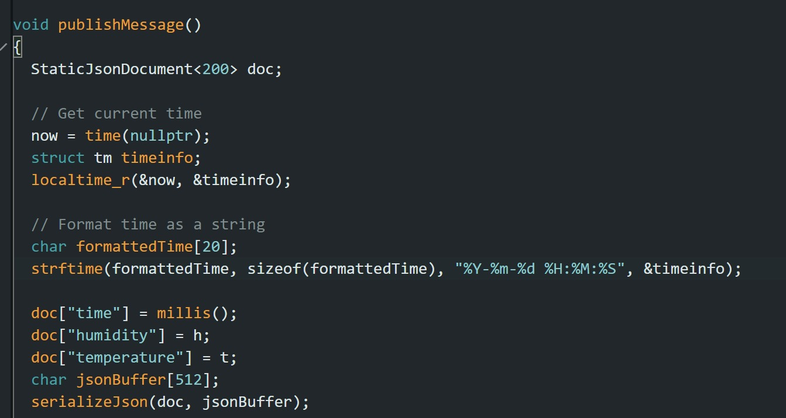
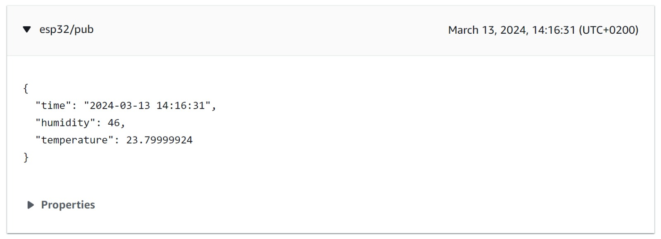
Info represented in cloud
Change the time format

Slide 13
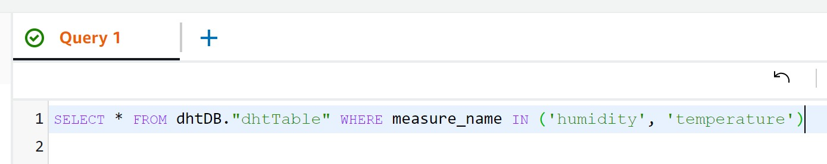
Define the rule for transfer the data from MQTT to timeStream
Choose which data to send to the Database

Slide 14
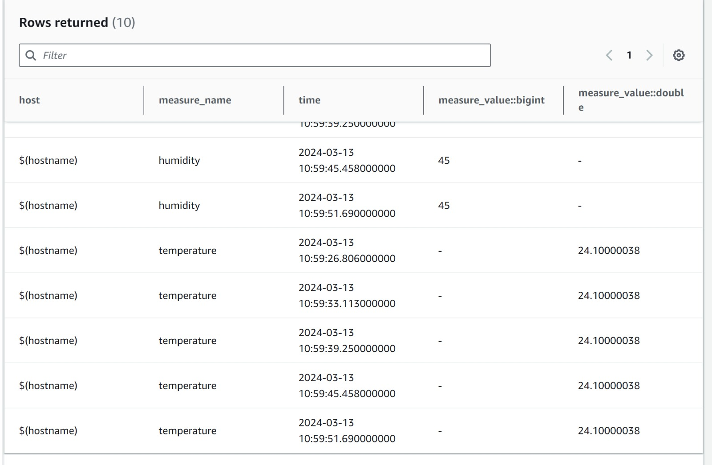

Slide 15
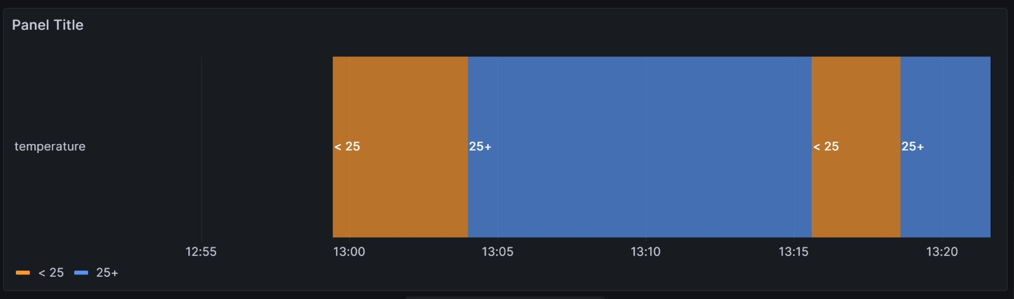
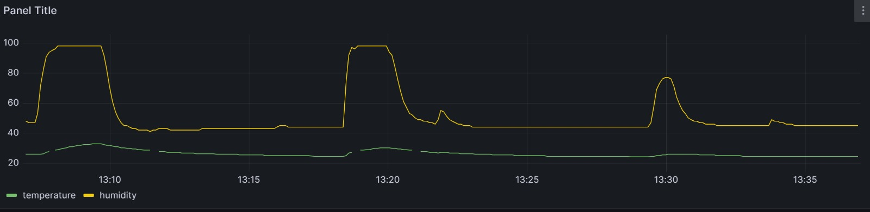
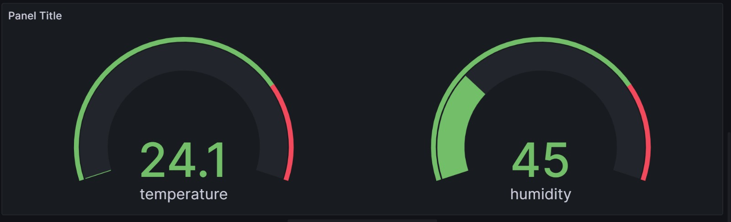
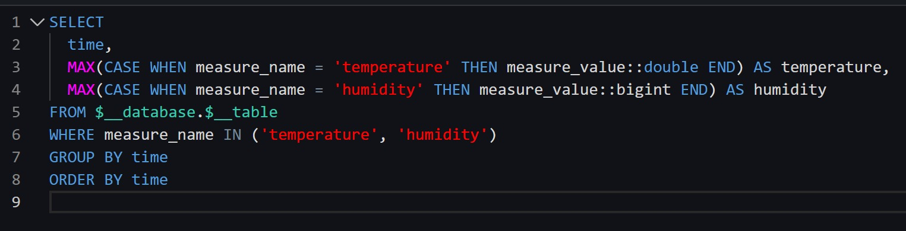
Visualization
Temp By Timeline
Combined Temp & Humidity measures
Gauge

Slide 16
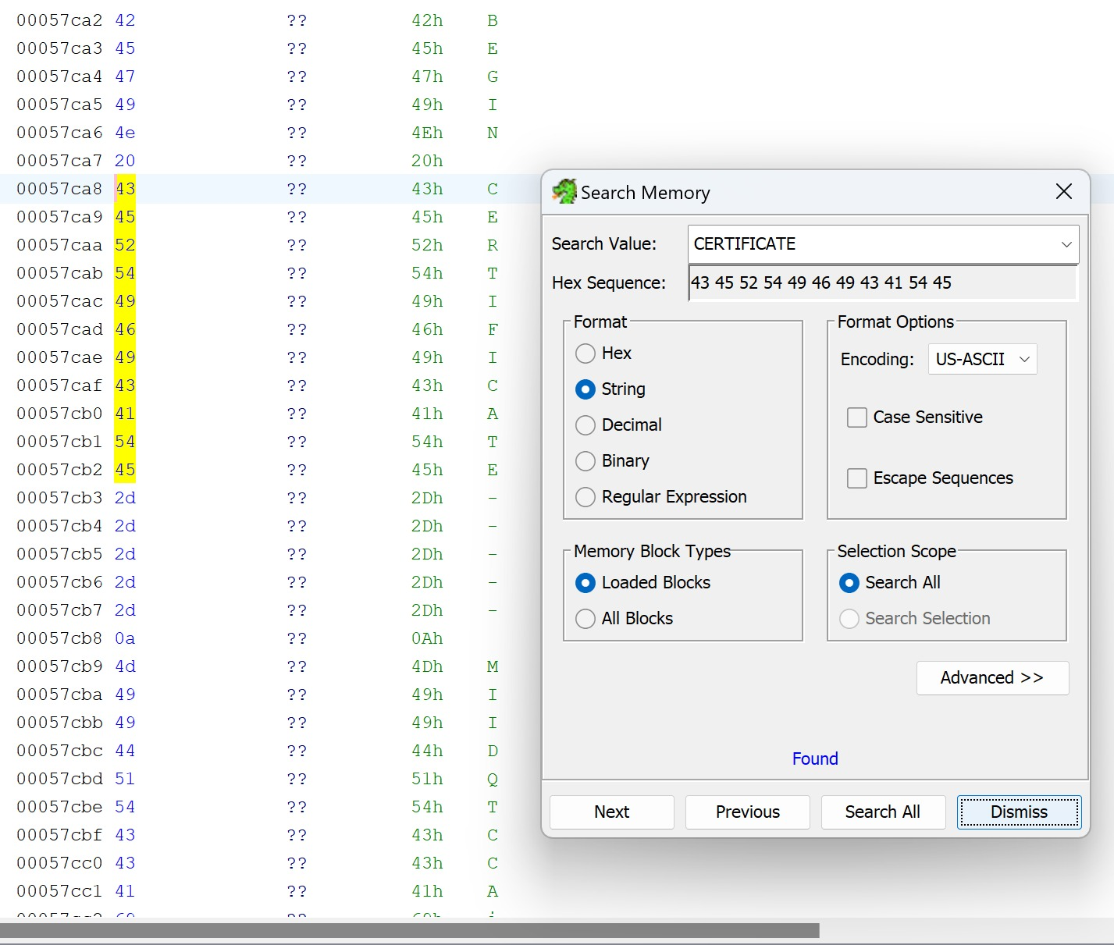

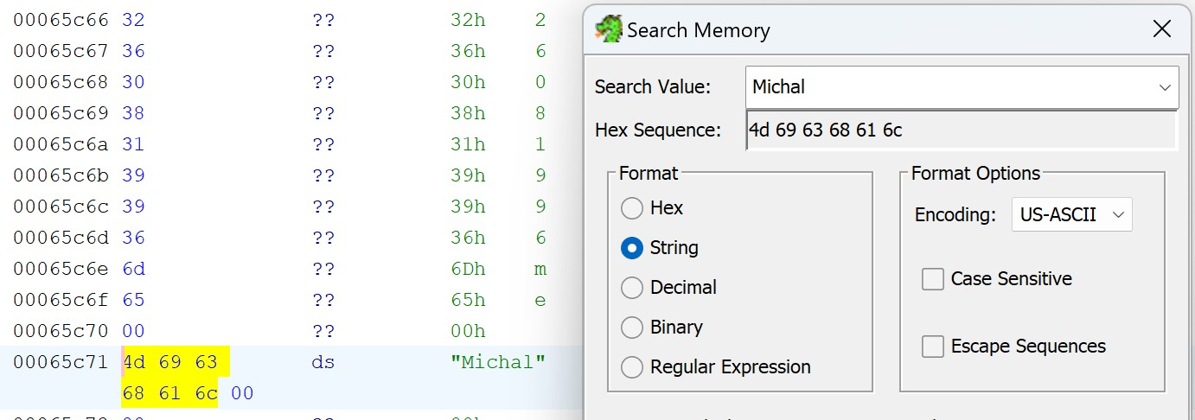
Security

Slide 17


THANK YOU
Do you have any questions?

